Slide 1
Healthhack 2015 The Royal Australian College of General Practitioners (RACGP) ROTATION ROSTER PORTAL
Contributors
(RACGP) Monika Buljan – Statistician And Project Owner
(RACGP) Hema Nathen – Project Analyst
Tim Rice – Various Mathematics And Statistics
Tania Licea – Designer/Project Manager
Miguel Sanchez – JS Expert
Terry Dai – Mobile App Developer
Rayen Magpantay – JS Expert
Notes:
5 seconds

Slide 2
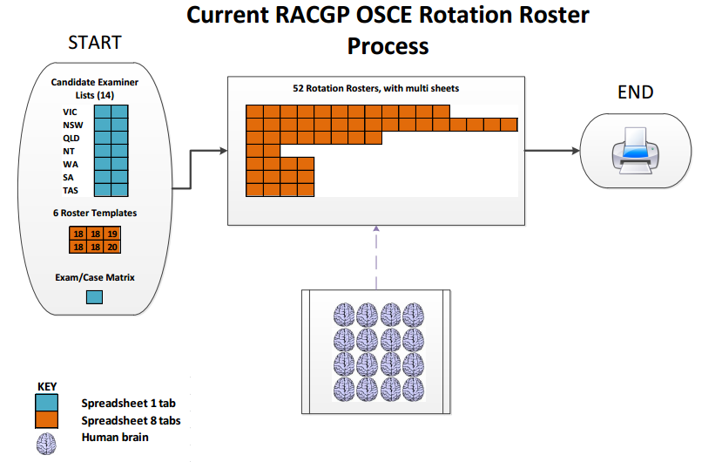
Issue definition
Notes:
30 seconds
The RACGP will run a clinical exam with over 800+ Candidates and over 2000 GP examiners.
Rotation Roster: candidates split in groups of 18-20 which equals 1 rotation, equals 1 spread sheet.
7 States coordinate multiple venues on the same date with am /pm sessions
Over 15 admins: Complete rosters according to availability of examiners; at the end, they print rosters.

Slide 3
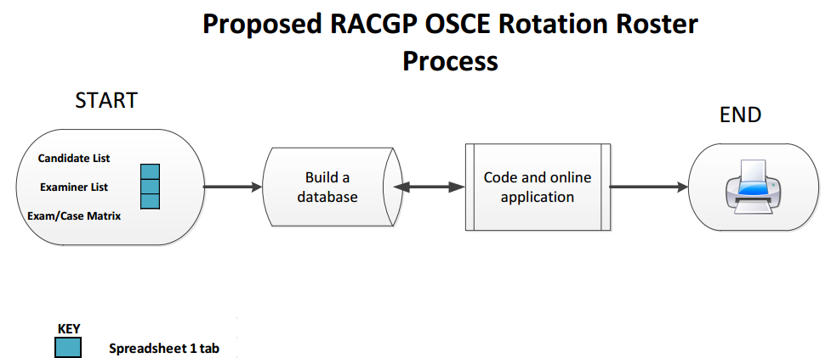
Proposed Solution
ROTATION ROSTER PORTAL
Notes:
30 seconds
The solution is to import 3 spread sheets into a database that connects to web portal allowing admins to coordinate and print rosters
Advantages:
More organised, used-friendly interface
-- Faster for Admins as they get a first draft of rosters and they just need to consider anomalies e.g. conflict of interest
– Admin don’t need to manage multiple spread sheets/ is an all in one system

Slide 4
PROTOTYPE
Notes:
45 seconds
log in
Roster generated by selecting Venue and AM/PM SESSION
The portal will be populate with the final roster
there is and edit function to replace fields or add colors
Then the candidate view and
the examiner view
printing capabilities by selecting locations
resources center to download templates and forms

Slide 5
Limitations and future work
LIMITATIONS / CHALLENGES
Replicate the Excel Master Roster in code (Web Portal).
Getting various components to work together (R- Mongo DB - NodeJS and Angular)
Time – To allow more functionalities e.g. Flexi start time, print formatting.
FUTURE
Consider the manual replacement of Examiners due to conflicts of interest.
Develop the Search function.
Detailed printing functions
Notes:
20 seconds
LIMITATIONS
not enough time to have flexibility for more functionalities

Slide 6
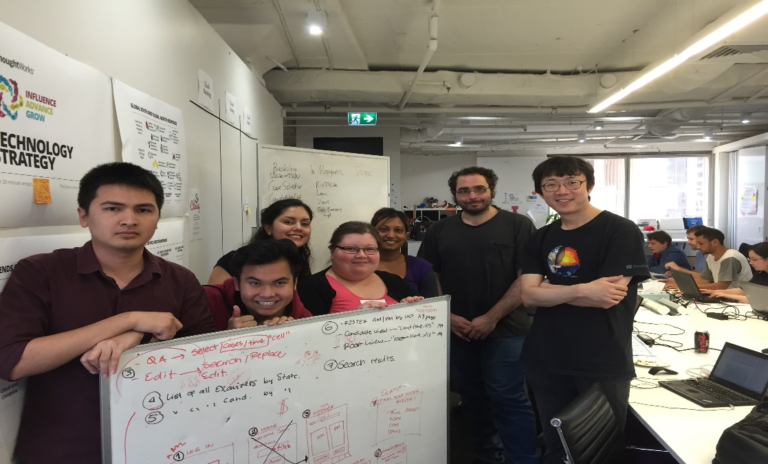
have a look at the live demo thanks!
Notes:
5 seconds

